Slide 1
It’s Me !

Slide 2
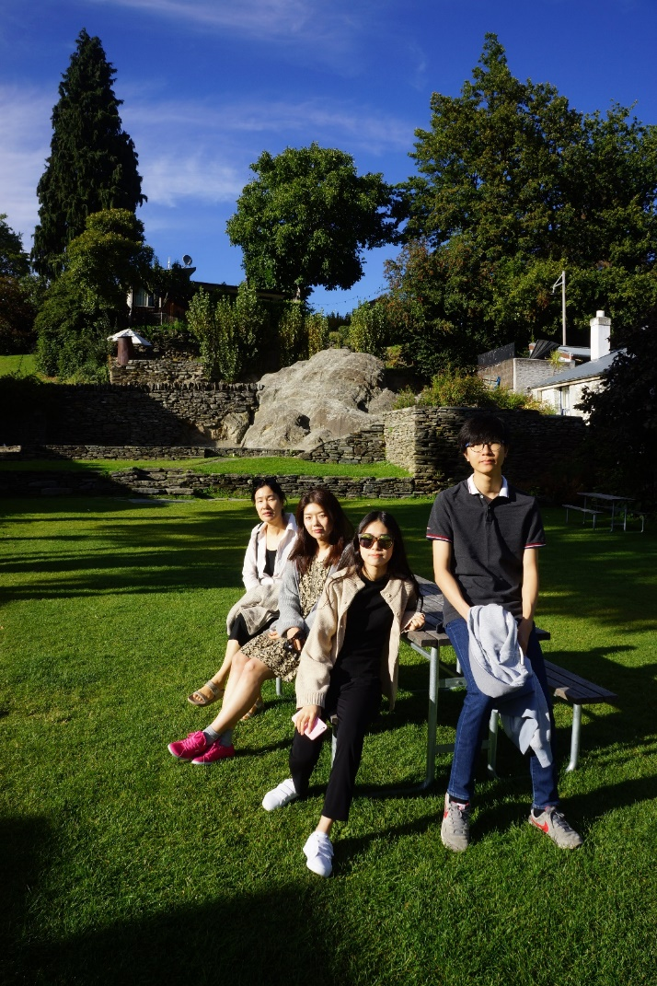
Kyung-Sik Jang 65. Born in JeonJu, KOREA Professor at School of Computer Science & Engineering KoreaTech ksjang@koreatech.ac.kr +81-10-9561-5678

Slide 3
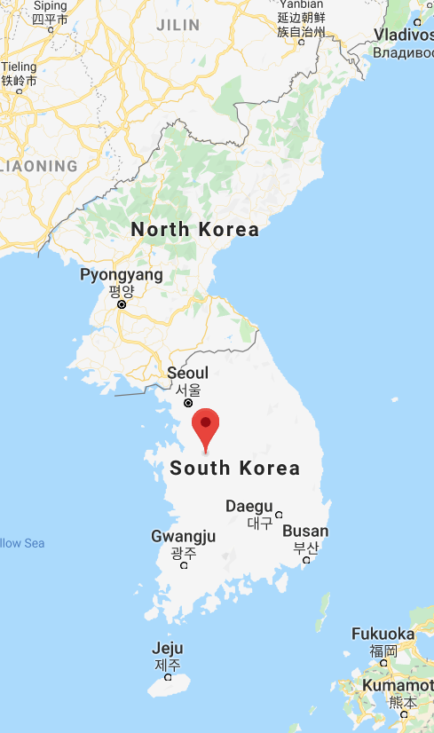
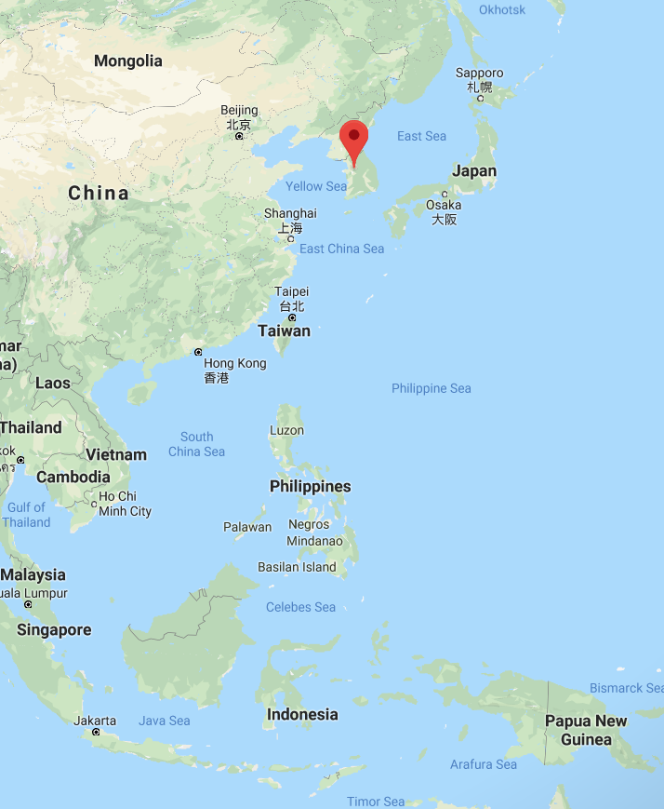
Where we are !

Slide 4

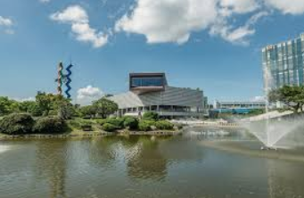




87. B.S in EE, Korea Univ. 89. M.S in EEE, KAIST 95. Ph.D in EEE, Tokyo Institute of Technology
Academic History

Slide 5



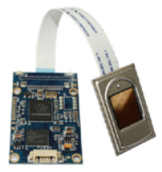
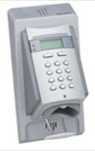
Vocational History
89~97 KT Research Center, Corporate Network, MPEG.
Samsung Electronics SystemLSI division
99~ Korea Institute of Technology & Education (KoreaTech)
2002~2013 CEO, BeyondLSI Korea
(Fingerprint, Vein, Copy-protection marker)

Slide 6
2018~ Natural Language Processing 2017~ Smart Factory 2013~ Vision Sensor 2000~ Embedded System 2005~13 Sensor Network 89~99 High-level Synthesis of ASIP
Research Interests
H/W-S/W Co-design
for Cognitive Techniques

Slide 7
Happy to meet .U. !!!

